Slide 1
Muthurangam arts and science college,vellore-2.
Vechicle management system using salesforce
Project sumitted by:-
Team leader:- D.Ranjana
Team member:- B.Preetha
Team member:- K.Pavithra
Team member:- M.pavithra

Slide 2
Content:-
Milestone 1:- creating developer account.
Milestone 2:-
* To create a object.
* To create driver object.
Milestone 3:-
* creation of fields.
* fields in driver object .
Milestone 4:-
*creation of vechicle management construction app.
Milestone 5:-
*create vechicle management profile and set its object permission.
Milestone 6:-
*create a user.
Milestone 7:-
*Reports and dashboards.
*Dashboards

Slide 3
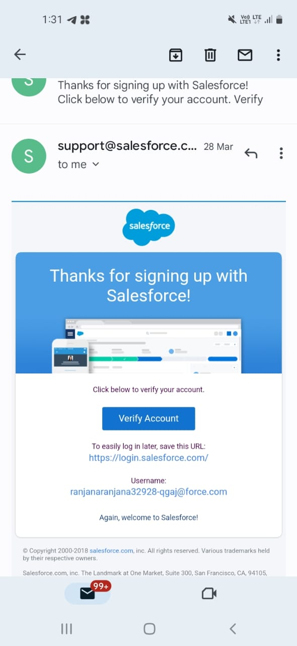
Milestone 1:-
Go to developer org in salesforce.
Click on sign up.
Enter the following details on the sign up form.
Click on sign up after filling these
Account activation :-
[click on verify to verify your account]
→

Slide 4
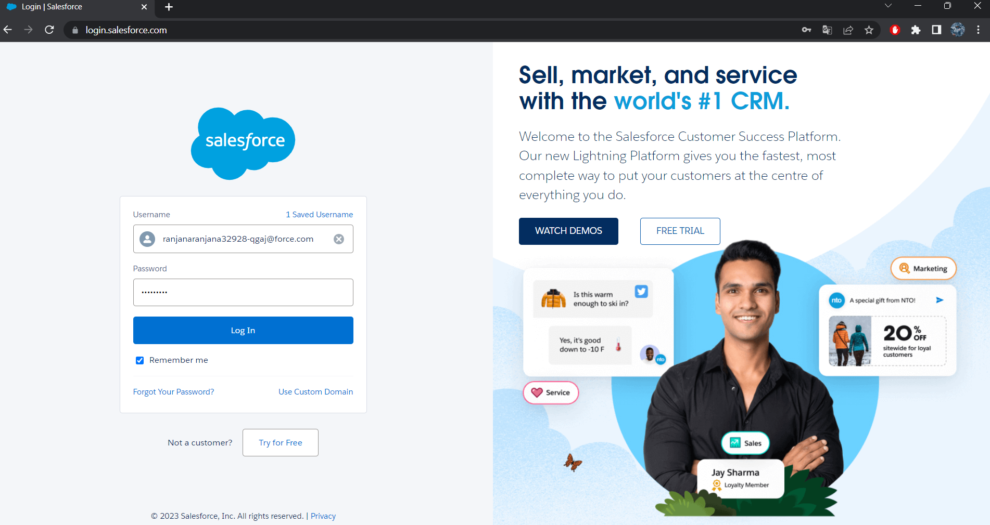
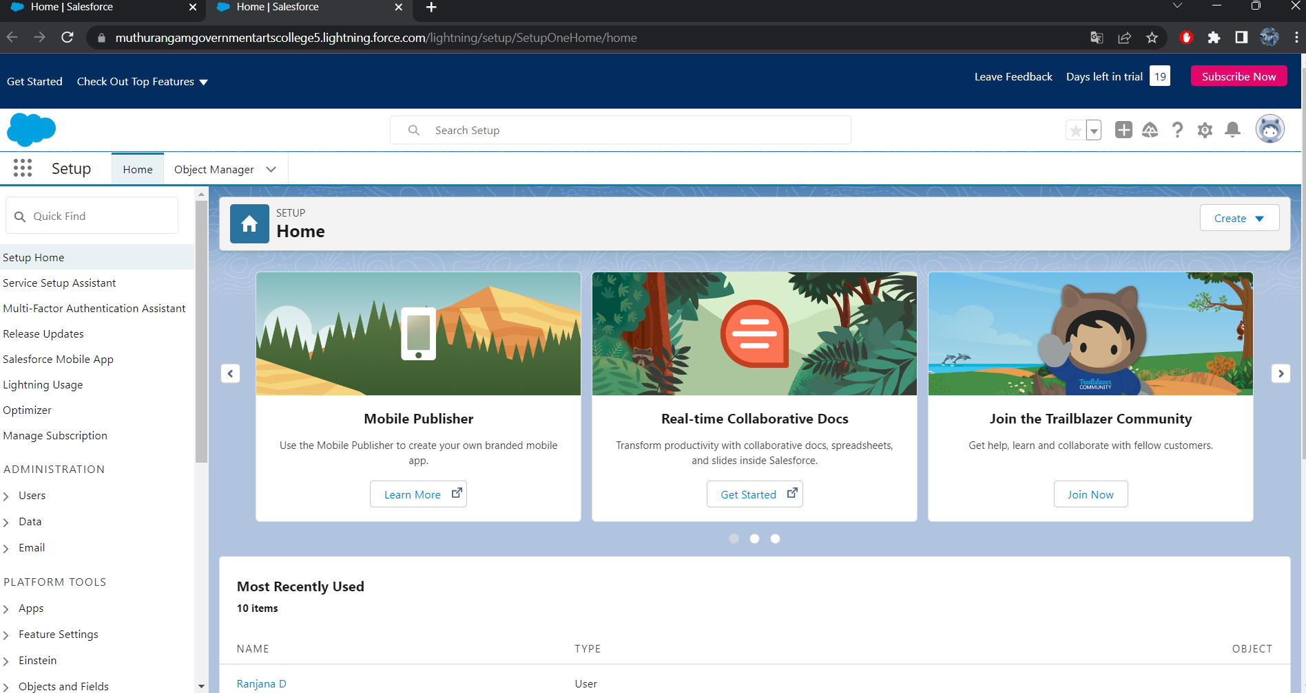
Login to salesforce account
Go to salesforce.com and click on login.
Enter the user name password that you just created.
After login this is the home page which you will see.
figure2:- figure3:-

Slide 5
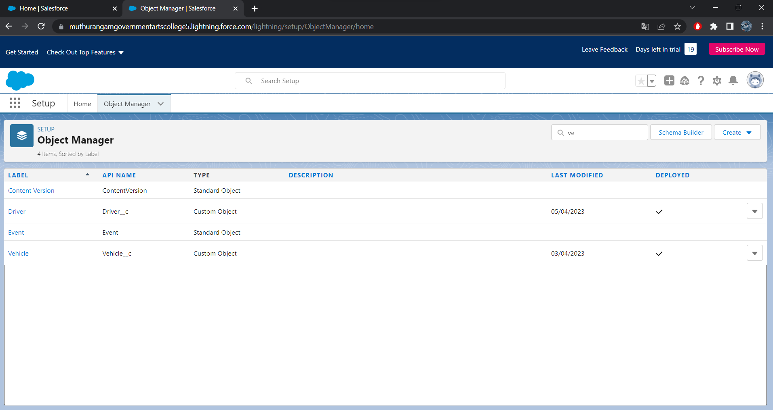
Milestone 2:-
To create an object:-
For vehicle management we need to create 2 object ; vehicle , Driver.
Create an object ,as vehicle and driver on the custom object definition page
Figure 4:-

Slide 6
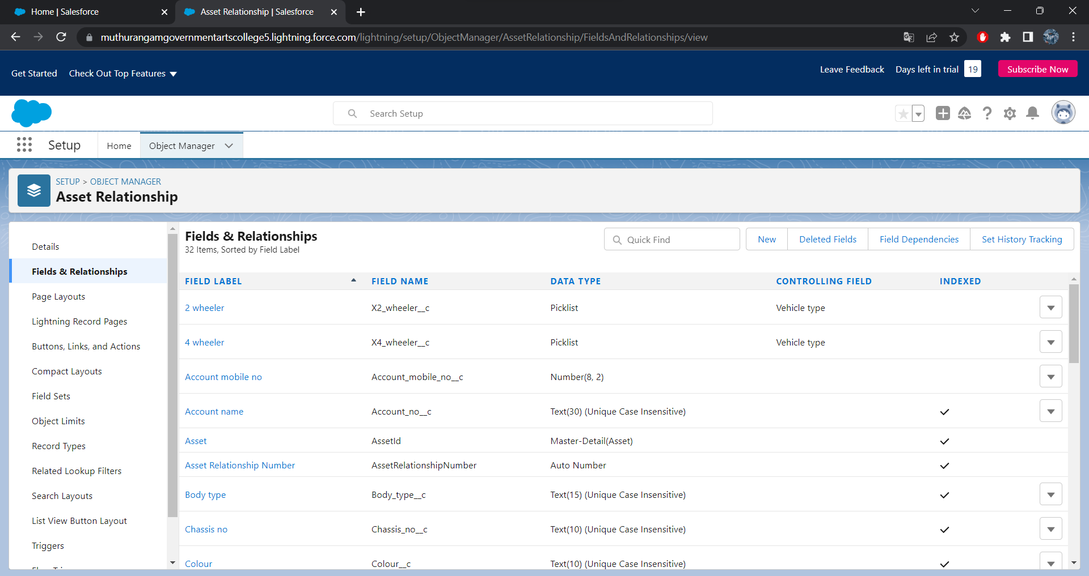
Milestone 3:-
Creating fields in objects:-
(now click field & realtionship New
Fill in the field label name Next Next save)
Figure4:-

Slide 7
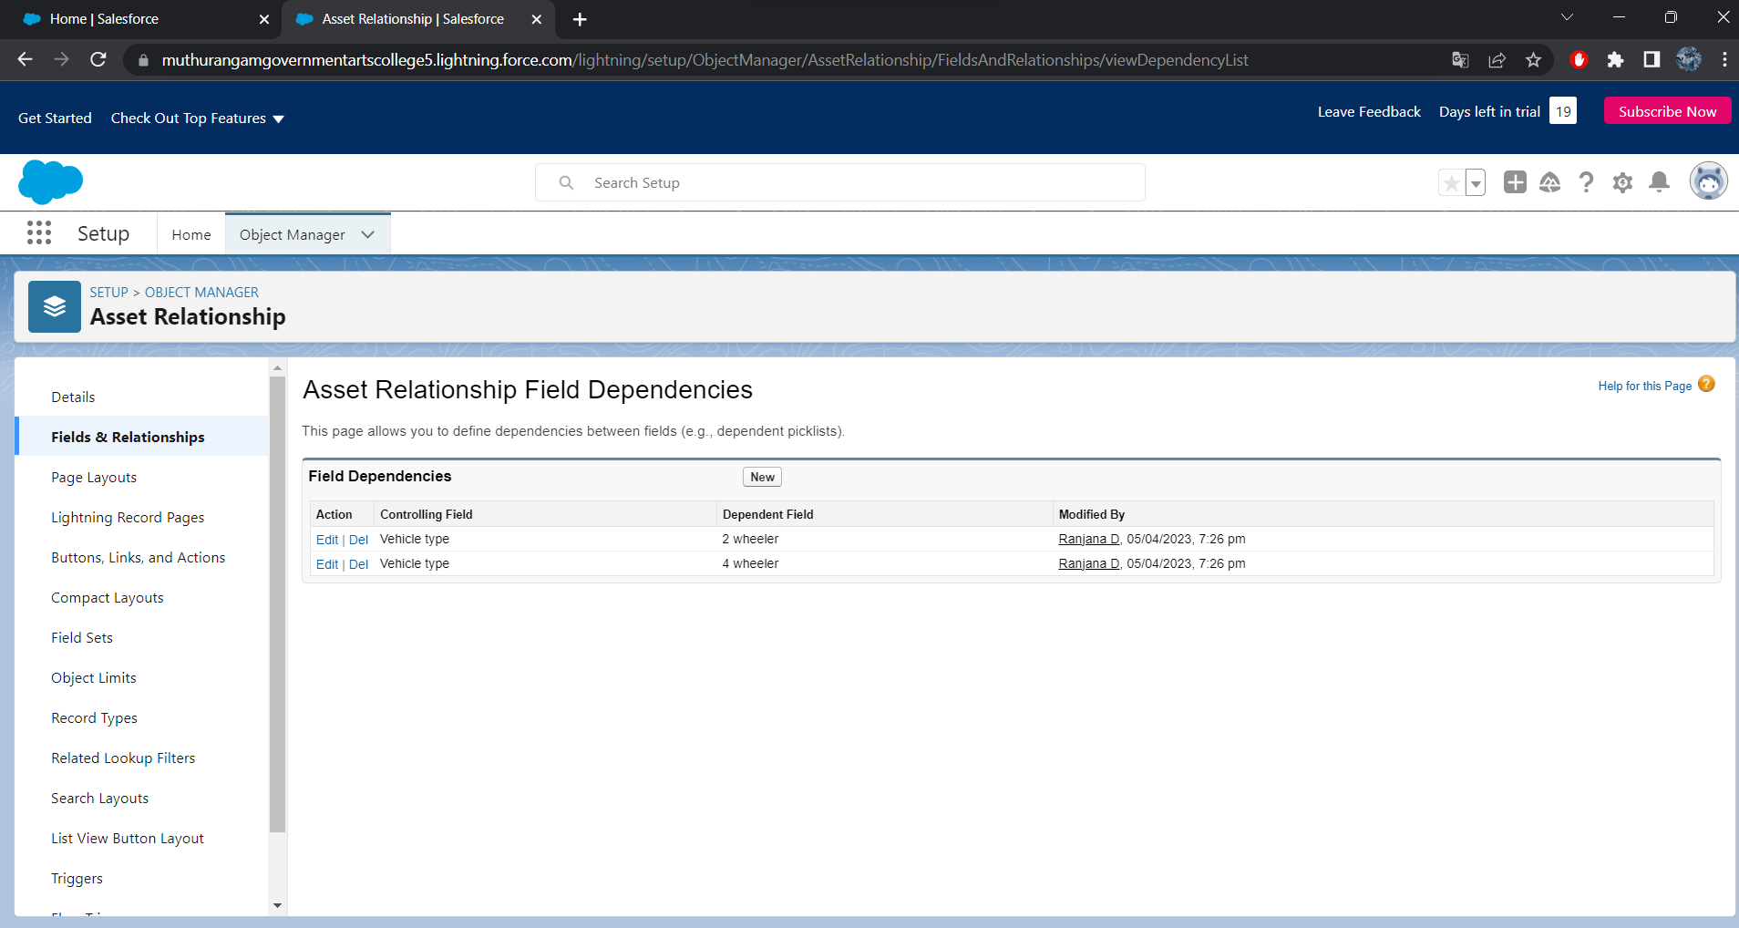
Fields in driver:-
Create dependency between two picklist so that when vehicle type is selected, 2 wheeler brands available in 2 wheeler field
In field &relationship click field dependencies.
select vehicle type as the controlling field 7select 2 wheeler as dependent field .
Select appropriate 2 wheeler brands.
Follow same steps for 4 wheeler also
Figure 5:-

Slide 8
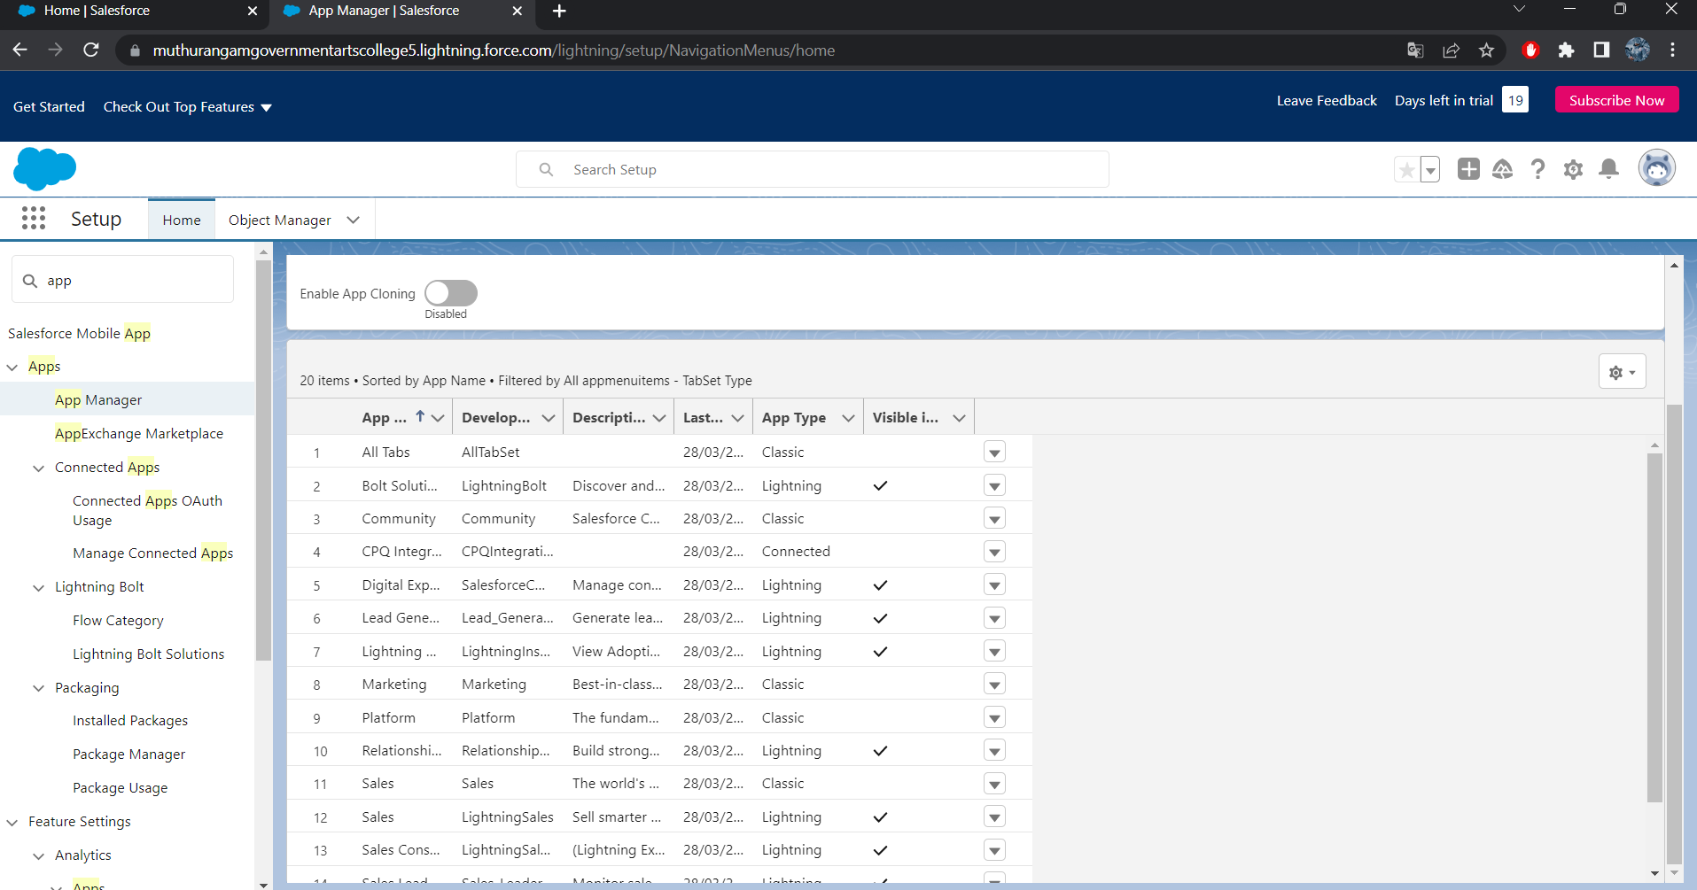
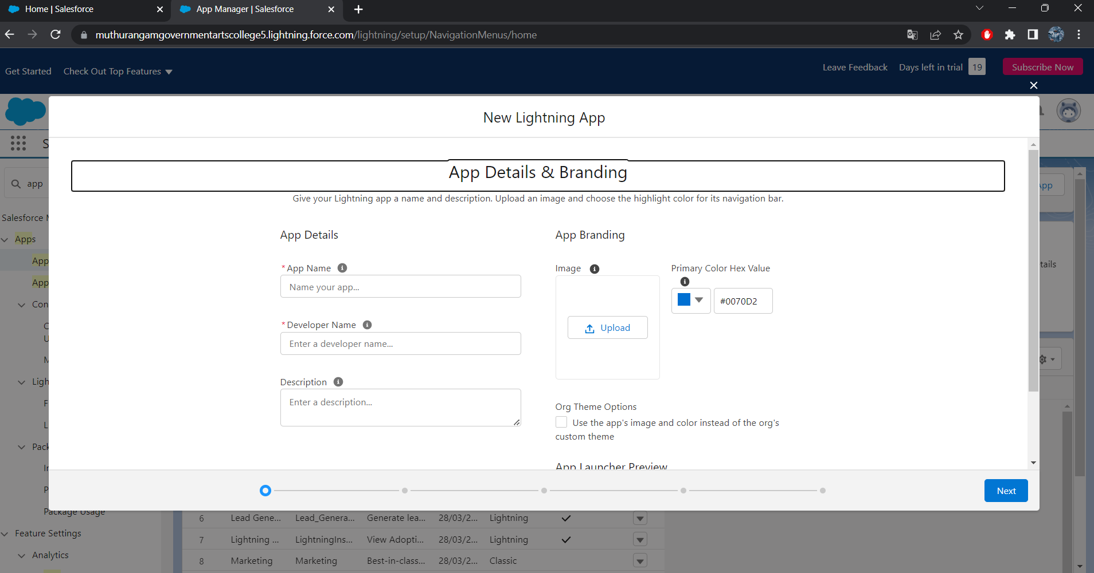
Milestone 4:-
Lightning app:-
Create vehicle management construction app
Click new lightning app. Enter vehicle management as the app name
App click next
utility click next
Available items, select accounts, contacts, oppurtunities, vehicle, driver, reports and dashboards
profiles – system administer click and save and finish
Figure6:- figure 7:-

Slide 9
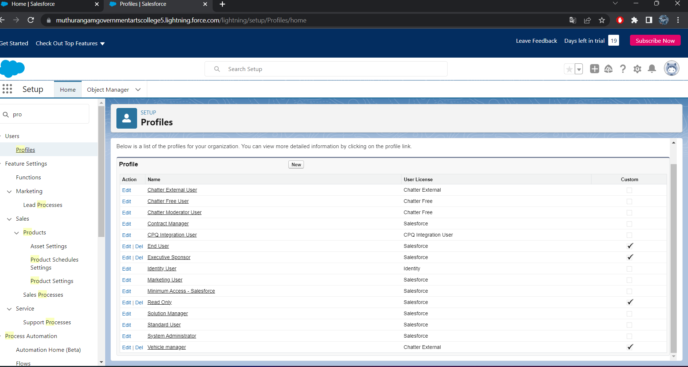
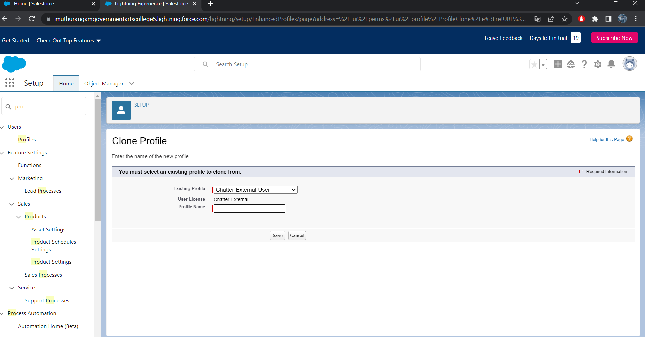
Milestone 5:-
Profile:-
To create new profile :-
Go to setup type profile in quick final box click on profiles clone the desired profile enter profile name save
Figure8:- figure9:-

Slide 10
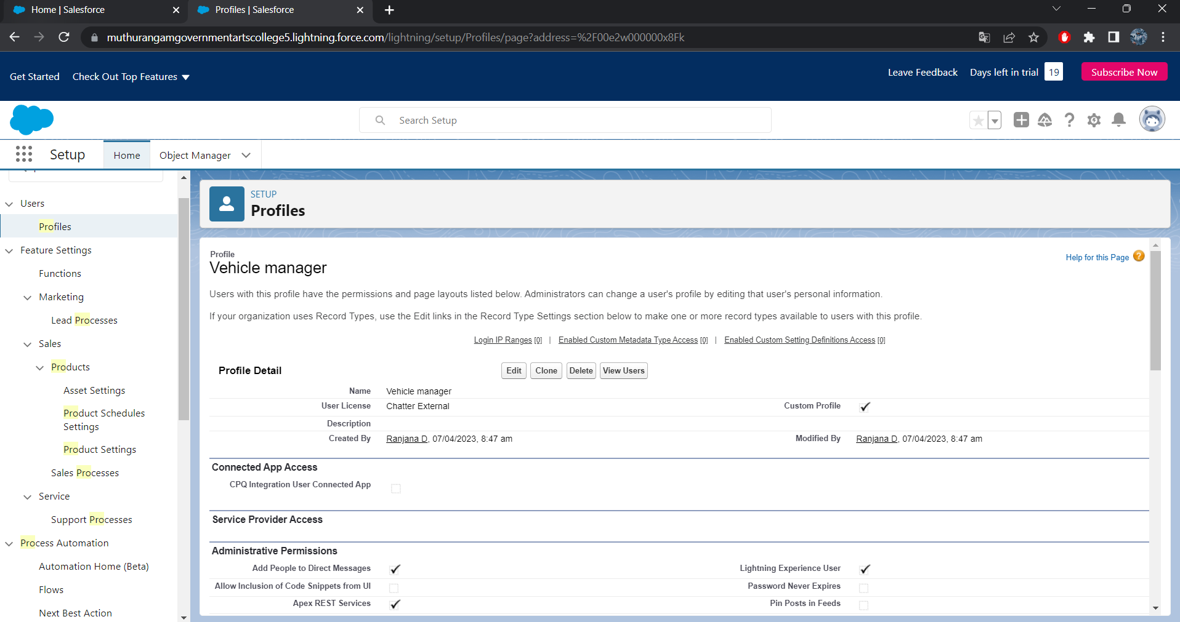
Figure 10:-

Slide 11
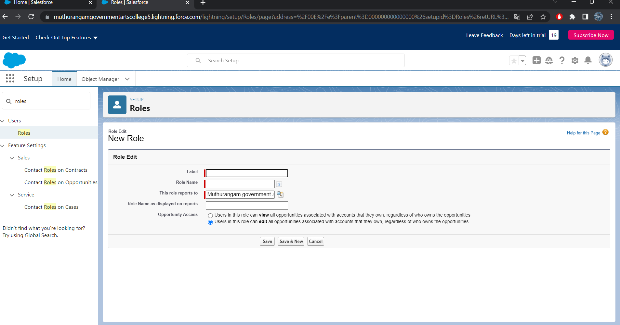
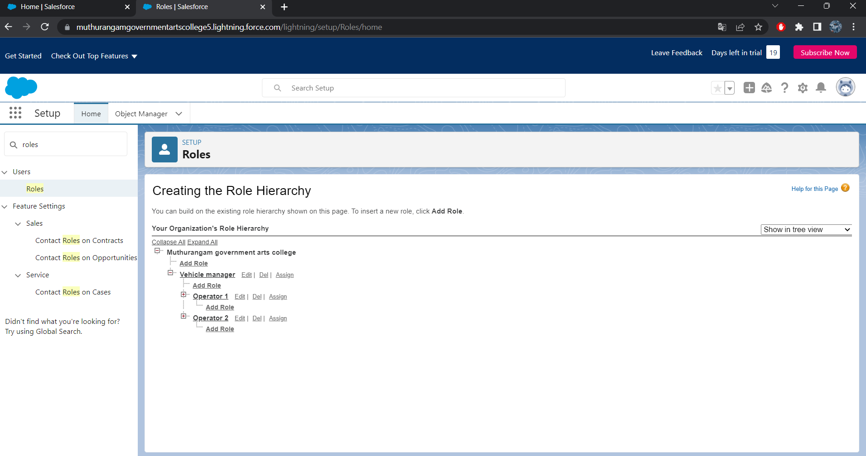
Set up roles :-
Set up Roles setup Roles expand all
Fill up label as vehicle manager, Role name vehicle manager
Create two operator 1 and 2 under vehicle manager
figure 11:- figure 12:-

Slide 12
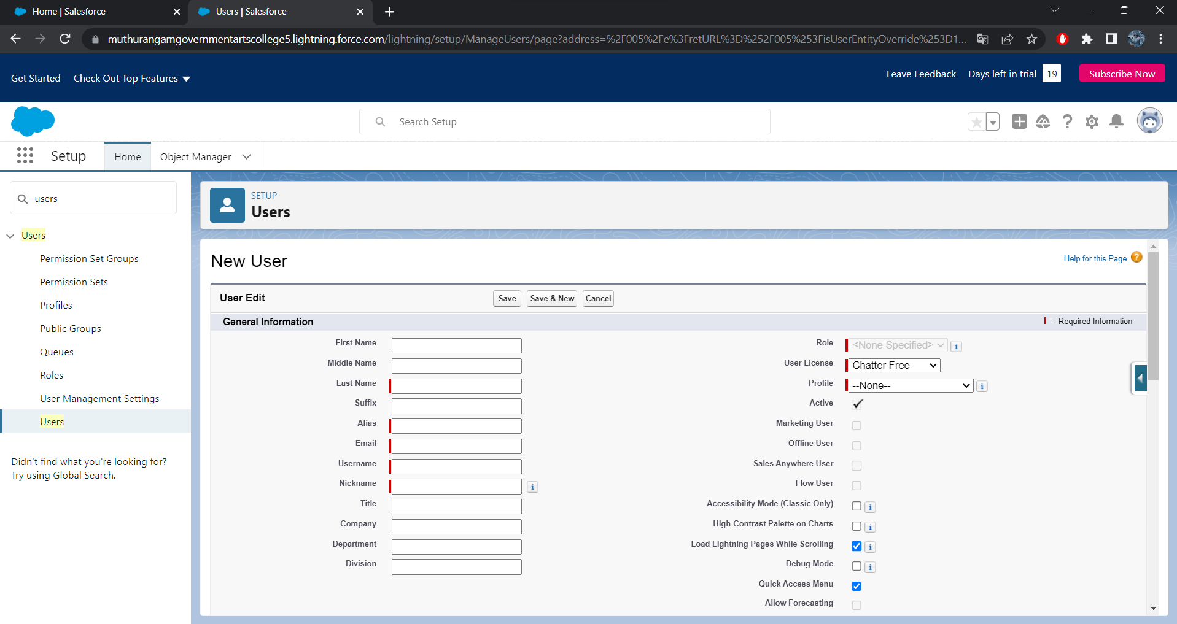
Milestone 6:-
In user
Select role as vehicle manager
User license as salesforce
Profile as vehicle manager
Also similar for operator 1 and operator 2
Figure 13:-

Slide 13
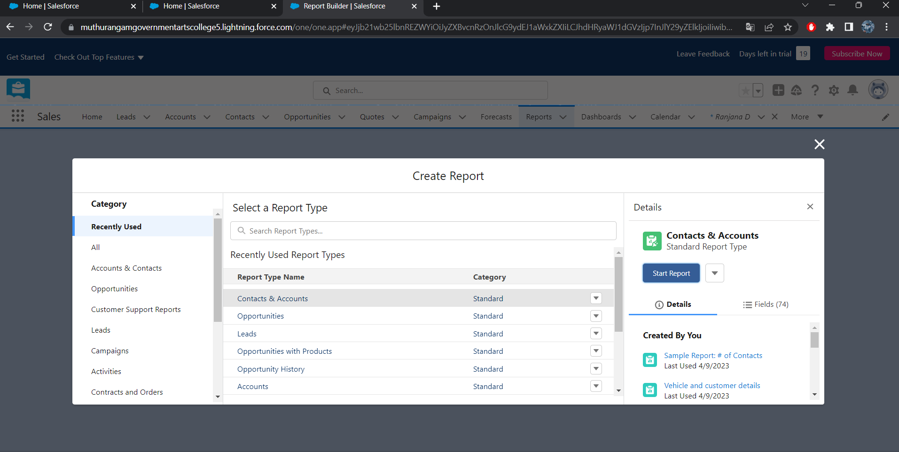
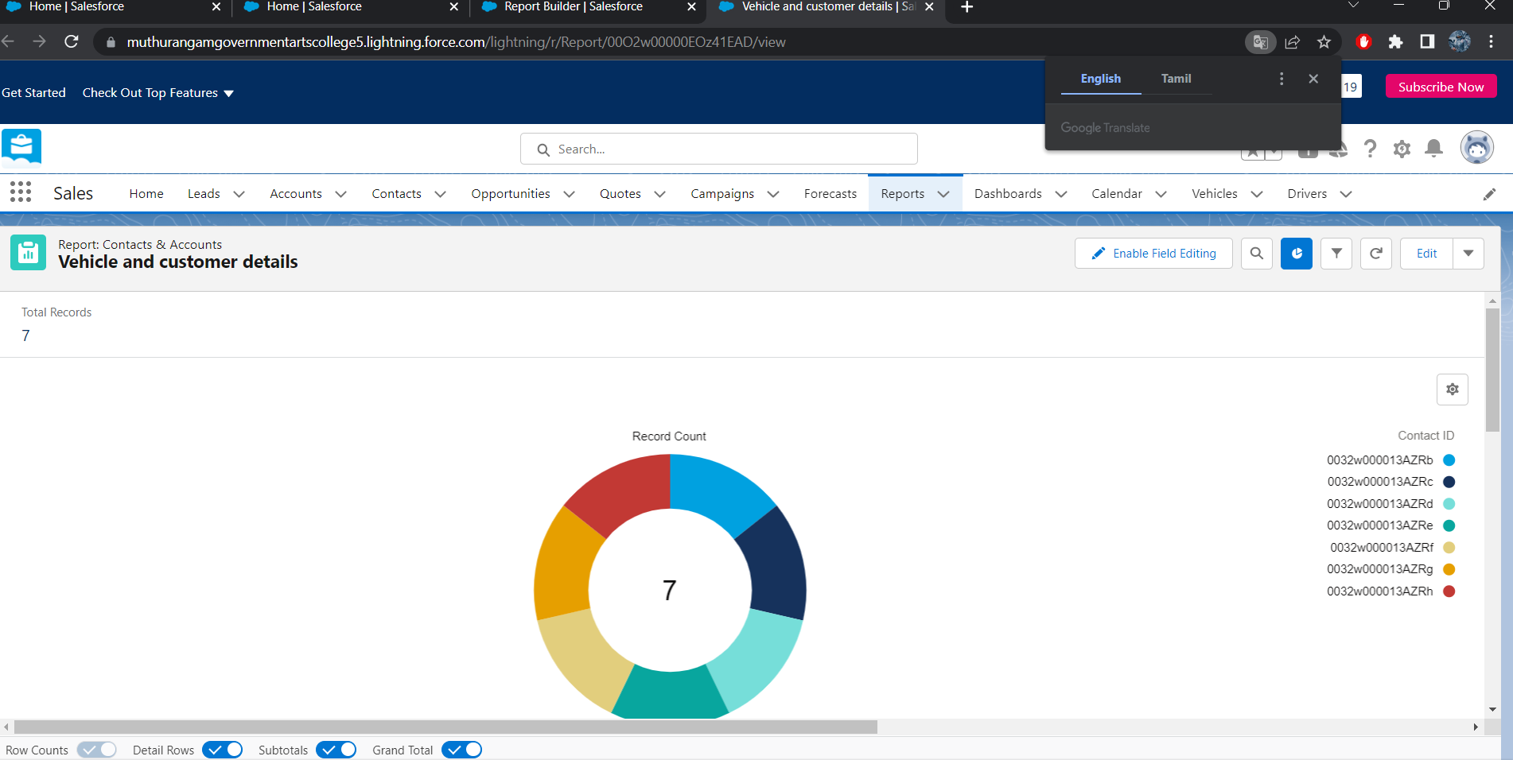
Milestone 7:-
Reports:
Go to report click New report
click filters select filters
add columns add vehicle
Click save
figure 14:- figure 15:-

Slide 14
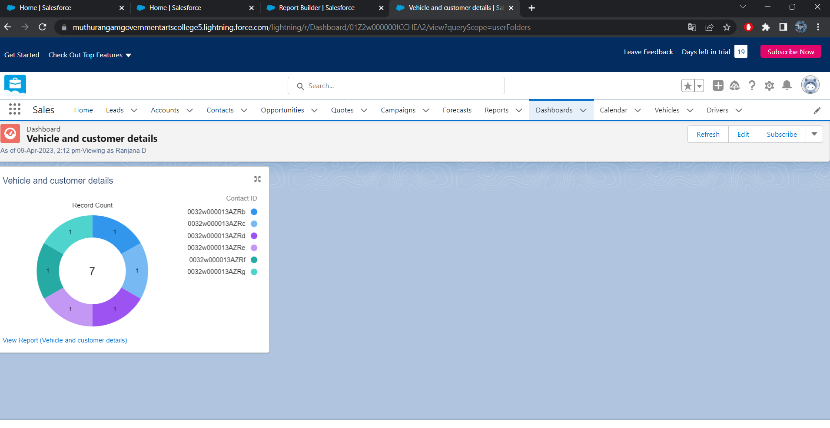
Dashboard :-
Click the dashboars tab
Click new dashboards
Name the dashboards vehicle and customer detail
Click click+component
Select the supplies report and click select
Vertile bar chart component and click add
Click save
Figure 16:-

Slide 15
THE END
OUR SINCERE GRATITUDE TO
*SALESFORCE
*SMARTBRIDGE(SMART
INTERN)

